Slide 1
SMART IRRIGATION SYSTEM USING IOT
(Agriculture)
RAVIKIRAN R
PRANESH RR

Slide 2
ABSTRACT
The main objective of this project is to enable the accessibility of the modern techniques to the farmers in order to make their work easier & comfortable. In this smart irrigation project we use IoT and a few serial communication devices which allow the farmers to control the process of irrigating the fields via the modern techniques.
We use intercommunicating devices such as Arduino, LoRa Shield and Node mcu which enables us to perform these processes and via this app we also provide suggestions to the farmers about the climatic conditions and the amount of water to be used for irrigating purposes. we can help the farmers to irrigate their fields whenever necessary irrespective of them being there, the main part/role is being played by the communication process between the app provided to the user and between the cloud, NodeMcu, LoRa module, Arduino and the flow controller.

Slide 3
PROBLEM STATEMENT
In this Modern Technological world Farmers have not yet at most received the modern Technologies in their Farming, During their Cultivation times they face certain problems like Water Scarcity, Inappropriate amount of Water Irrigated to the Field and also Less Manpower for Irrigation. If less water is Irrigated for the Field either due to Less man power or Water Scarcity, then it reduces the Quality as well as the in the Production of Crops.
To Overcome these kind of Problem we can implement the Idea Smart irrigation system using IOT. In this System the Irrigation system will be Automated so Adequate amount of Water will be Supplied to the Field so there Wont be Less or Excess Water Irrigated, Which helps us to control the Water Scarcity. This system also does not require any Human Manpower so the Farmer can Irrigate the Field any time he require without the Assistance of manpower.

Slide 4
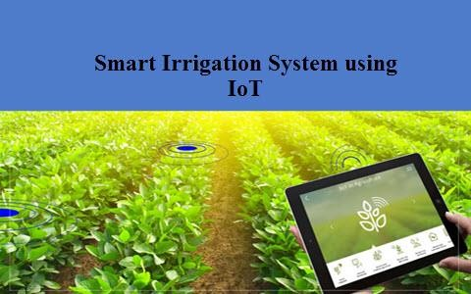
SOLUTION
The Farmers use the Irrigation system (using motor) in the Field to deploy the water. But nowadays due to the less Manpower and Water Drought in some areas we can use the Technology to overcome those troubles. In this Smart Irrigation project, we use some IOT based devices which are capable of automating the Irrigation process by Monitoring the amount of water flow and analyzing the moisture control of the soil. Through this system the Farmers will be able to control the Irrigation system irrespective to the manpower and also consume needed amount of Water.
In the Smart Irrigation system, we Some IOT devices and a App using Cloud which transfers Data from the Farmer to the motor. In Farmers mobile we install a App using cloud through this the Farmer will be able to release the needed or Certain amount of water for the particular field. In the App it will have certain options like Low Amount of Water, Medium Amount of Water, High Amount of Water. The Motor will also be disabled by the data given by the Moisture control sensor. The moisture sensor will give the data about the soil of particular field to the farmers Mobile phone accordingly the farmer will be able to deploy the needed amount of water to that particular Area. The Data given by the farmer is transmitted to the Node MCU which is fixed in the Field.
The Node MCU Transfers the analyzed data to the ARDUINO UNO through the Lora
Shield (wireless modulation device). The ARDUINO UNO is Situated near the Motor Controller and gives the output information to motor regarding the deploying amount of water. Accordingly deployed amount of water flows into the particular fields.

Slide 5
PROJECT PLAN
SOLUTION
The Assembling and connectivity between the Microcontrollers has a lot of work to do but even it will be very easy for the Farmers to Handle it from their Mobile phones. NODE MCU is a single board Microcontroller which helps in operating any open source firmware prototyping board designs. . It receives Wireless data from the cloud app in Mobile phone. The Data is Forwarded to Lora shield device because this device enables the transmission of wireless modulation for Long range. The Lora Shield forwards the Data to the ARDUINO UNO board which is situated near the motor. The Board receives the input data through the UNO pin and gives data through the Digital Output pin which is connected to the motor controller. Based on this the water is deployed in the several farm lands. And also several Arduino uno boards are attached near separate pipelines to control separate water line and to collect the information about the Moisture of the Soil. The Moisture sensor is fixed in a adjacent manner cause even though the water gets stagnant or deficit the moisture sensor will be able to acquire accurate information about the soil and give the data to the Arduino accordingly the Arduino will release the amount of water according with the Threshold amount of the soil moisture.

Slide 6
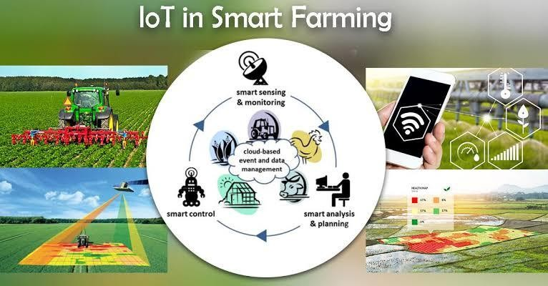
FLOW CHART
APP(Cloud)
MOTOR CONTROLLER
NODEMCU
ARDUINO UNO
LORASHIELD

Slide 7
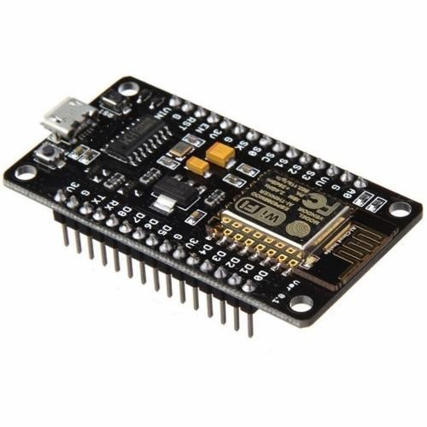
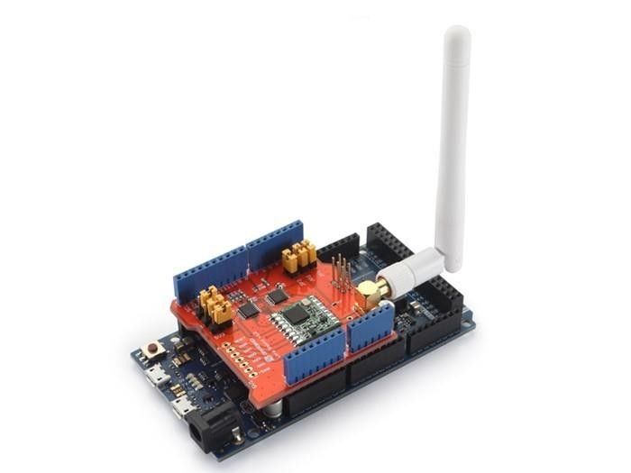
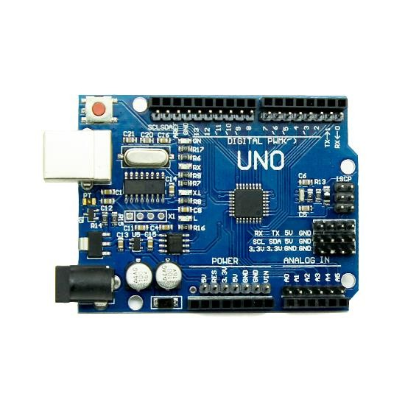
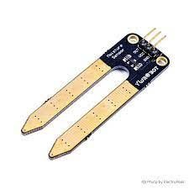
TECHNOLOGY STACK
In this project We use Intercommunicating devices such as Arduino UNO, LoRa Shield, Node mcu, Moisture Sensor and Motor Controller which enables us to perform these processes.
We use an App via Cloud to transfer the Data from the Farmers Mobile phone to the NodeMCU which will further transfer the data to the Arduino through the Lora Shield. The Arduino controls the Motor in the Irrigation system by the Data which it receives.
Node MCU
Lora Shield
Arduino
Moisture Sensor

Slide 8
FUTURE ASPECT
In the future Aspects the Smart Irrigation can be Developed or Updated by using Drone Technologies which requires Less Maintenance But The Drone Technologies need to implemented in a Simple manner so that the Farmers can Easily habitat.

Slide 9


Ravikiran R
Pranesh RR
Star Communication

